Slide 1
Java Basics
Java Programming Language

Slide 2
Disclaimer
Document Name:
Data Classification: CONFIDENTIAL
Disclaimer
The contents of this document are property of Softtek, and are classified as Confidential. Any reproduction in whole or in part is strictly prohibited without the written permission of Softtek.
This document is subject to change. Comments, corrections or questions should be directed to the author.
Audience/Viewership | Purpose
Revision Chart
The following chart list the revisions made to this document. Use this to describe the changes and additions each time this document is re-published. The description should be detailed as possible and include the names of the reviewers who request the changes.
Version No. | Version Date | Types of Changes | Owner/Author | Date of Review/Expiration

Slide 3
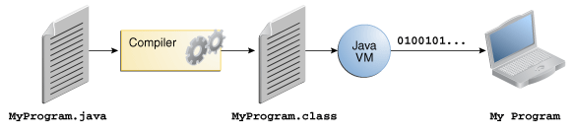
Java Programming Language
The Java programming language is a general-purpose, concurrent, class-based, object-oriented language.
In the Java programming language, all source code is first written in plain text files ending with the .java extension
The source files are then compiled into .class files by the javac compiler.

Slide 4
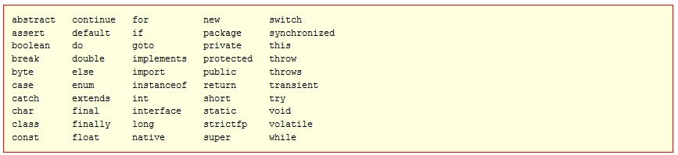
Java Keywords
You cannot use any of the following as identifiers in your programs.
The keywords const and goto are reserved, even though they are not currently used. true, false, and null might seem like keywords, but they are actually literals.

Slide 5
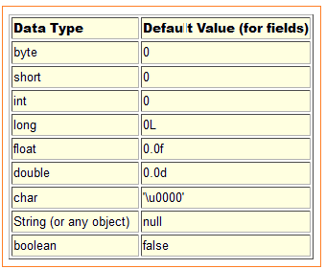
Primitive Data Types
The Java programming language is statically-typed, which means that all variables must first be declared before they can be used.
The Java programming language supports seven other primitive data types.

Slide 6
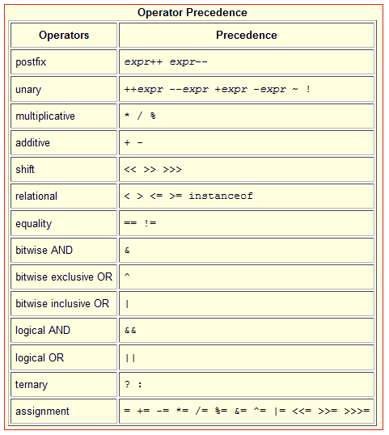
Operators
Operators are special symbols that perform specific operations on one, two, or three operands, and then return a result.
The operators in the following table are listed according to precedence order. The closer to the top of the table an operator appears, the higher its precedence.
Operators on the same line have equal precedence.
All binary operators except for the assignment operators are evaluated from left to right; assignment operators are evaluated right to left.

Slide 7
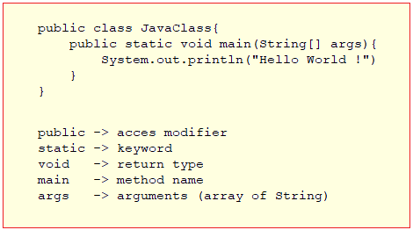
The main method
In the Java programming language, every application must contain a main method.
The main method it's the entry point for your application and will subsequently invoke all the other methods required by your program.

Slide 8
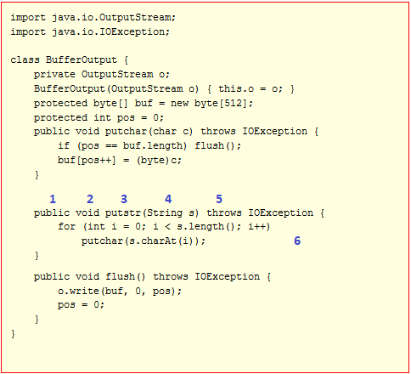
Methods
A method declares executable code that can be invoked, passing a fixed number of values as arguments.
By convention, method names should be a verb in lowercase or a multi-word name that begins with a verb in lowercase, followed by adjectives, nouns, etc.
In multi-word names, the first letter of each of the second and following words should be capitalized.
Modifiers – public, private, protected, static, synchronized.
The return type
The method name
The parameter list in parentheses
An exception list
The method body, enclosed between braces

Slide 9
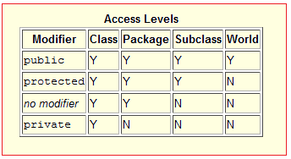
Access Modifiers
Access level modifiers determine whether other classes can use a particular field or invoke a particular method.
There are two levels of access control:
At the top level—public, or package-private (no explicit modifier).
At the member level—public, private, protected, or package-private (no explicit modifier).
There are four types of Java access modifiers:
Private: The access level of a private modifier is only within the class. It cannot be accessed from outside the class.
Default: The access level of a default modifier is only within the package. It cannot be accessed from outside the package. If you do not specify any access level, it will be the default.
Protected: The access level of a protected modifier is within the package and outside the package through child class.
Public: The access level of a public modifier is everywhere. It can be accessed from within the class, outside the class, within the package and outside the package.

Slide 10
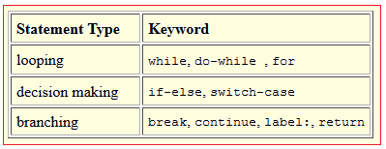
Control Flow Statements
Control flow statements, however, break up the flow of execution by employing decision making, looping, and branching, enabling your program to conditionally execute particular blocks of code.
All conditional statements use the truth or falsehood of a conditional expression to determine the execution path.
Three types of control flow statements:
Decision-making statements.
Looping statements.
Branching statements.

Slide 11
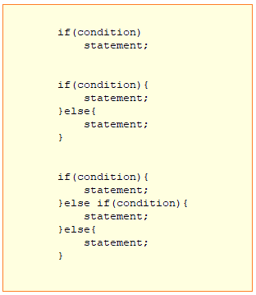
The if-then statement
It tells your program to execute a certain section of code only if a particular test evaluates to true.
The if-then-else statement provides a secondary path of execution when an "if" clause evaluates to false.

Slide 12
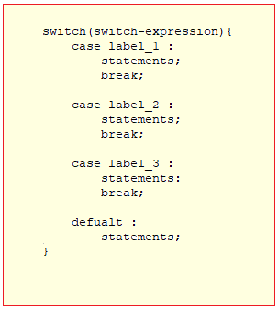
The switch statement
Unlike if-then and if-then-else statements, the switch statement can have a number of possible execution paths.
A switch works with the byte, short, char, and int primitive data types.
It also works with enumerated types, the String class, and a few special classes that wrap certain primitive types: Character, Byte, Short, and Integer.
If the value of the switch-expression matches a case label, the execution starts from the matched case label and executes all statements until the break statement is encountered.
If the value of the switch-expression does not match a case label, execution starts at the statement following the optional default label and continues until the end of the switch statement or the break statement is encountered.

Slide 13
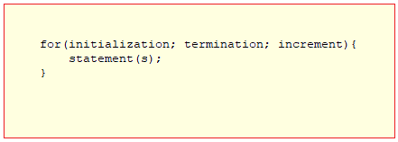
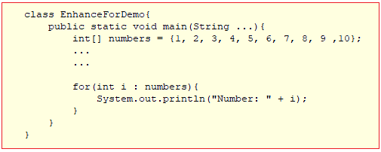
The for statement
The for statement provides a compact way to iterate over a range of values.
It repeatedly loops until a particular condition is satisfied.
The initialization expression initializes the loop; it's executed once, as the loop begins.
When the termination expression evaluates to false, the loop terminates.
The increment expression is invoked after each iteration through the loop; it is perfectly acceptable for this expression to increment or decrement a value.
The for statement also has another form designed for iteration through Collections and arrays.
This form is sometimes referred to as the enhanced for statement and can be used to make your loops more compact and easier to read.

Slide 14
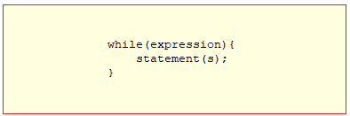
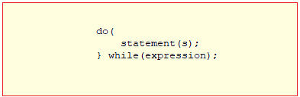
The while and do while statements
The while statement continually executes a block of statements while a particular condition is true.
The while statement continues testing the expression and executing its block until the expression evaluates to false.
The difference between do-while and while is that do-while evaluates its expression at the bottom of the loop instead of the top. Therefore, the statements within the do block are always executed at least once
Note that the do-while statement ends with a semicolon. The condition-expression must be a boolean expression.

Slide 15
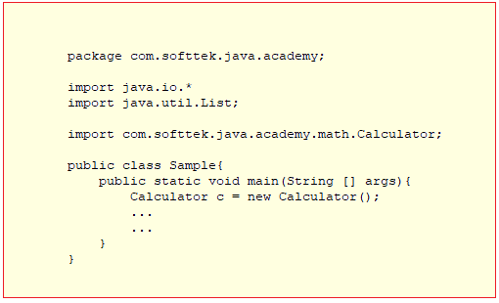
Java Packages
Programs are organized as sets of packages. Each package has its own set of names for types, which helps to prevent name conflicts.
The naming structure for packages is hierarchical.
The members of a package are class and interface types.
To create a package, you choose a name for the package and put a package statement with that name at the top of every source file that contains the types (classes, interfaces, enumerations, and annotation types) that you want to include in the package.
The package statement must be the first line in the source file.
There can be only one package statement in each source file, and it applies to all types in the file.
Package names are written in all lower case to avoid conflict with the names of classes or interfaces.
Packages in the Java language itself begin with java. or javax.

Slide 16
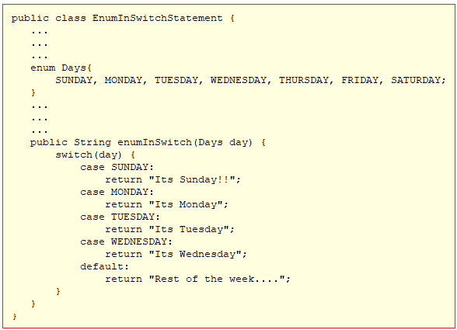
Enum Types
An enum type is a special data type that enables for a variable to be a set of predefined constants.
The variable must be equal to one of the values that have been predefined for it.
Because Java enums are constants, the names of an enum type's fields are in uppercase letters.
To define an enum type, use the enum keyword.

Slide 17
Resources
Java Tutorial
https://docs.oracle.com/javase/tutorial/index.html
Java SE Documentation
https://docs.oracle.com/javase/8/docs/api/
Java Specification
https://docs.oracle.com/javase/specs/index.html

